Slide 1












Multi-model Intercomparison Project on the Saskatchewan-Nelson-Churchill River Basin (Nelson-MiP project)
Monthly meeting - April 08th, 2020
Manitoba Infrastructure

Slide 2
Agenda
Decision on time periods for model calibration/validation
Selection of natural gauge stations for calibration for Phase 1
Presentation of HYPE configuration and input (Ajay - UofC)
Presentation of SWAT-GIW configuration and input (Ameer - WSA)
Presentation of MH-WATFLOOD and input (Manitoba Hydro)
Presentation of SWAT-RRB configuration and input (Yinlong - UofM)
Deliverables for next meeting & follow-up

Slide 3
Time periods for calibration/validation
Model spin-up: Sept./Oct. 1979 - 1982
Calibration period: 1992 - 2008
1983 - 1991
Validation periods:
2009 - 2016
Years | 80 |  |  |  |  | 85 |  |  |  |  | 90 |  |  |  |  | 95 |  |  |  |  | 00 |  |  |  |  | 05 |  |  |  |  | 10 |  |  |  |  | 15 |  |  | 18
Periods |  | WET |  |  |  |  | DRY |  |  |  |  |  |  |  |  |  | WET & DRY |  |  |  |  |  |  |  |  |  | WET |  |  |  |  | WET & DRY

Slide 4
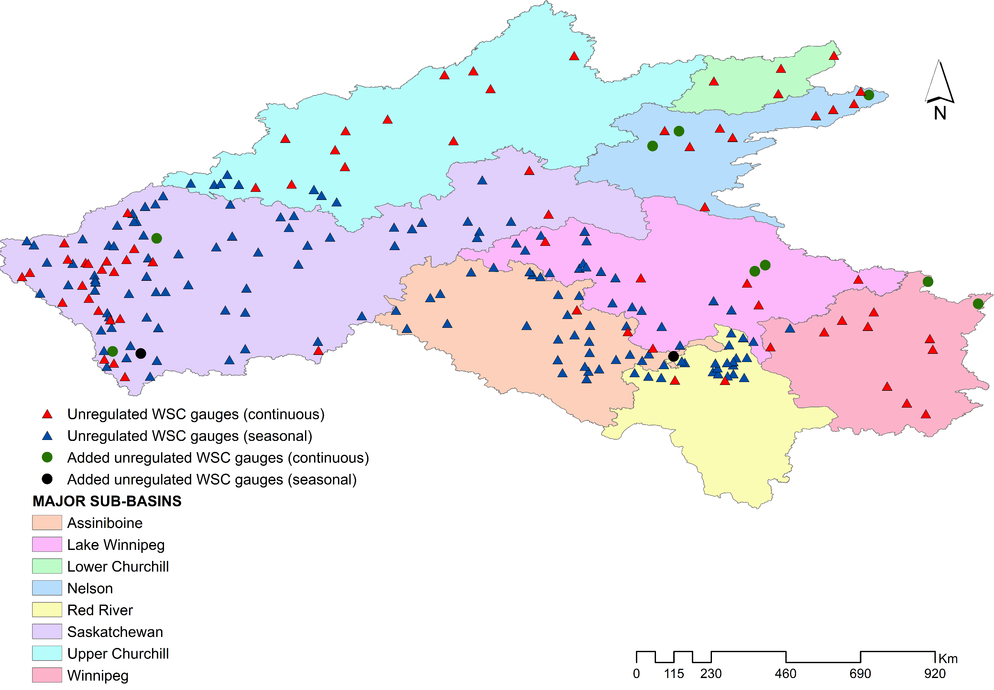
Selection of natural gauge stations for calibration/validation - continuous vs seasonal
Sub-basins | Number of WSC natural stations
Assiniboine | 32
Lake Winnipeg | 28
Winnipeg river | 13
Upper Churchill | 20
Lower Churchill | 4
Saskatchewan river | 94
Red River | 23
Nelson river | 12
Station == Natural & Data Period == 1970 to 2016 &
Total Years >= 35 & Drainage area >= 200 km²
+ Stations submitted but not meeting search criteria
291 (natural) gauge stations identified + 11 stations added

Slide 5
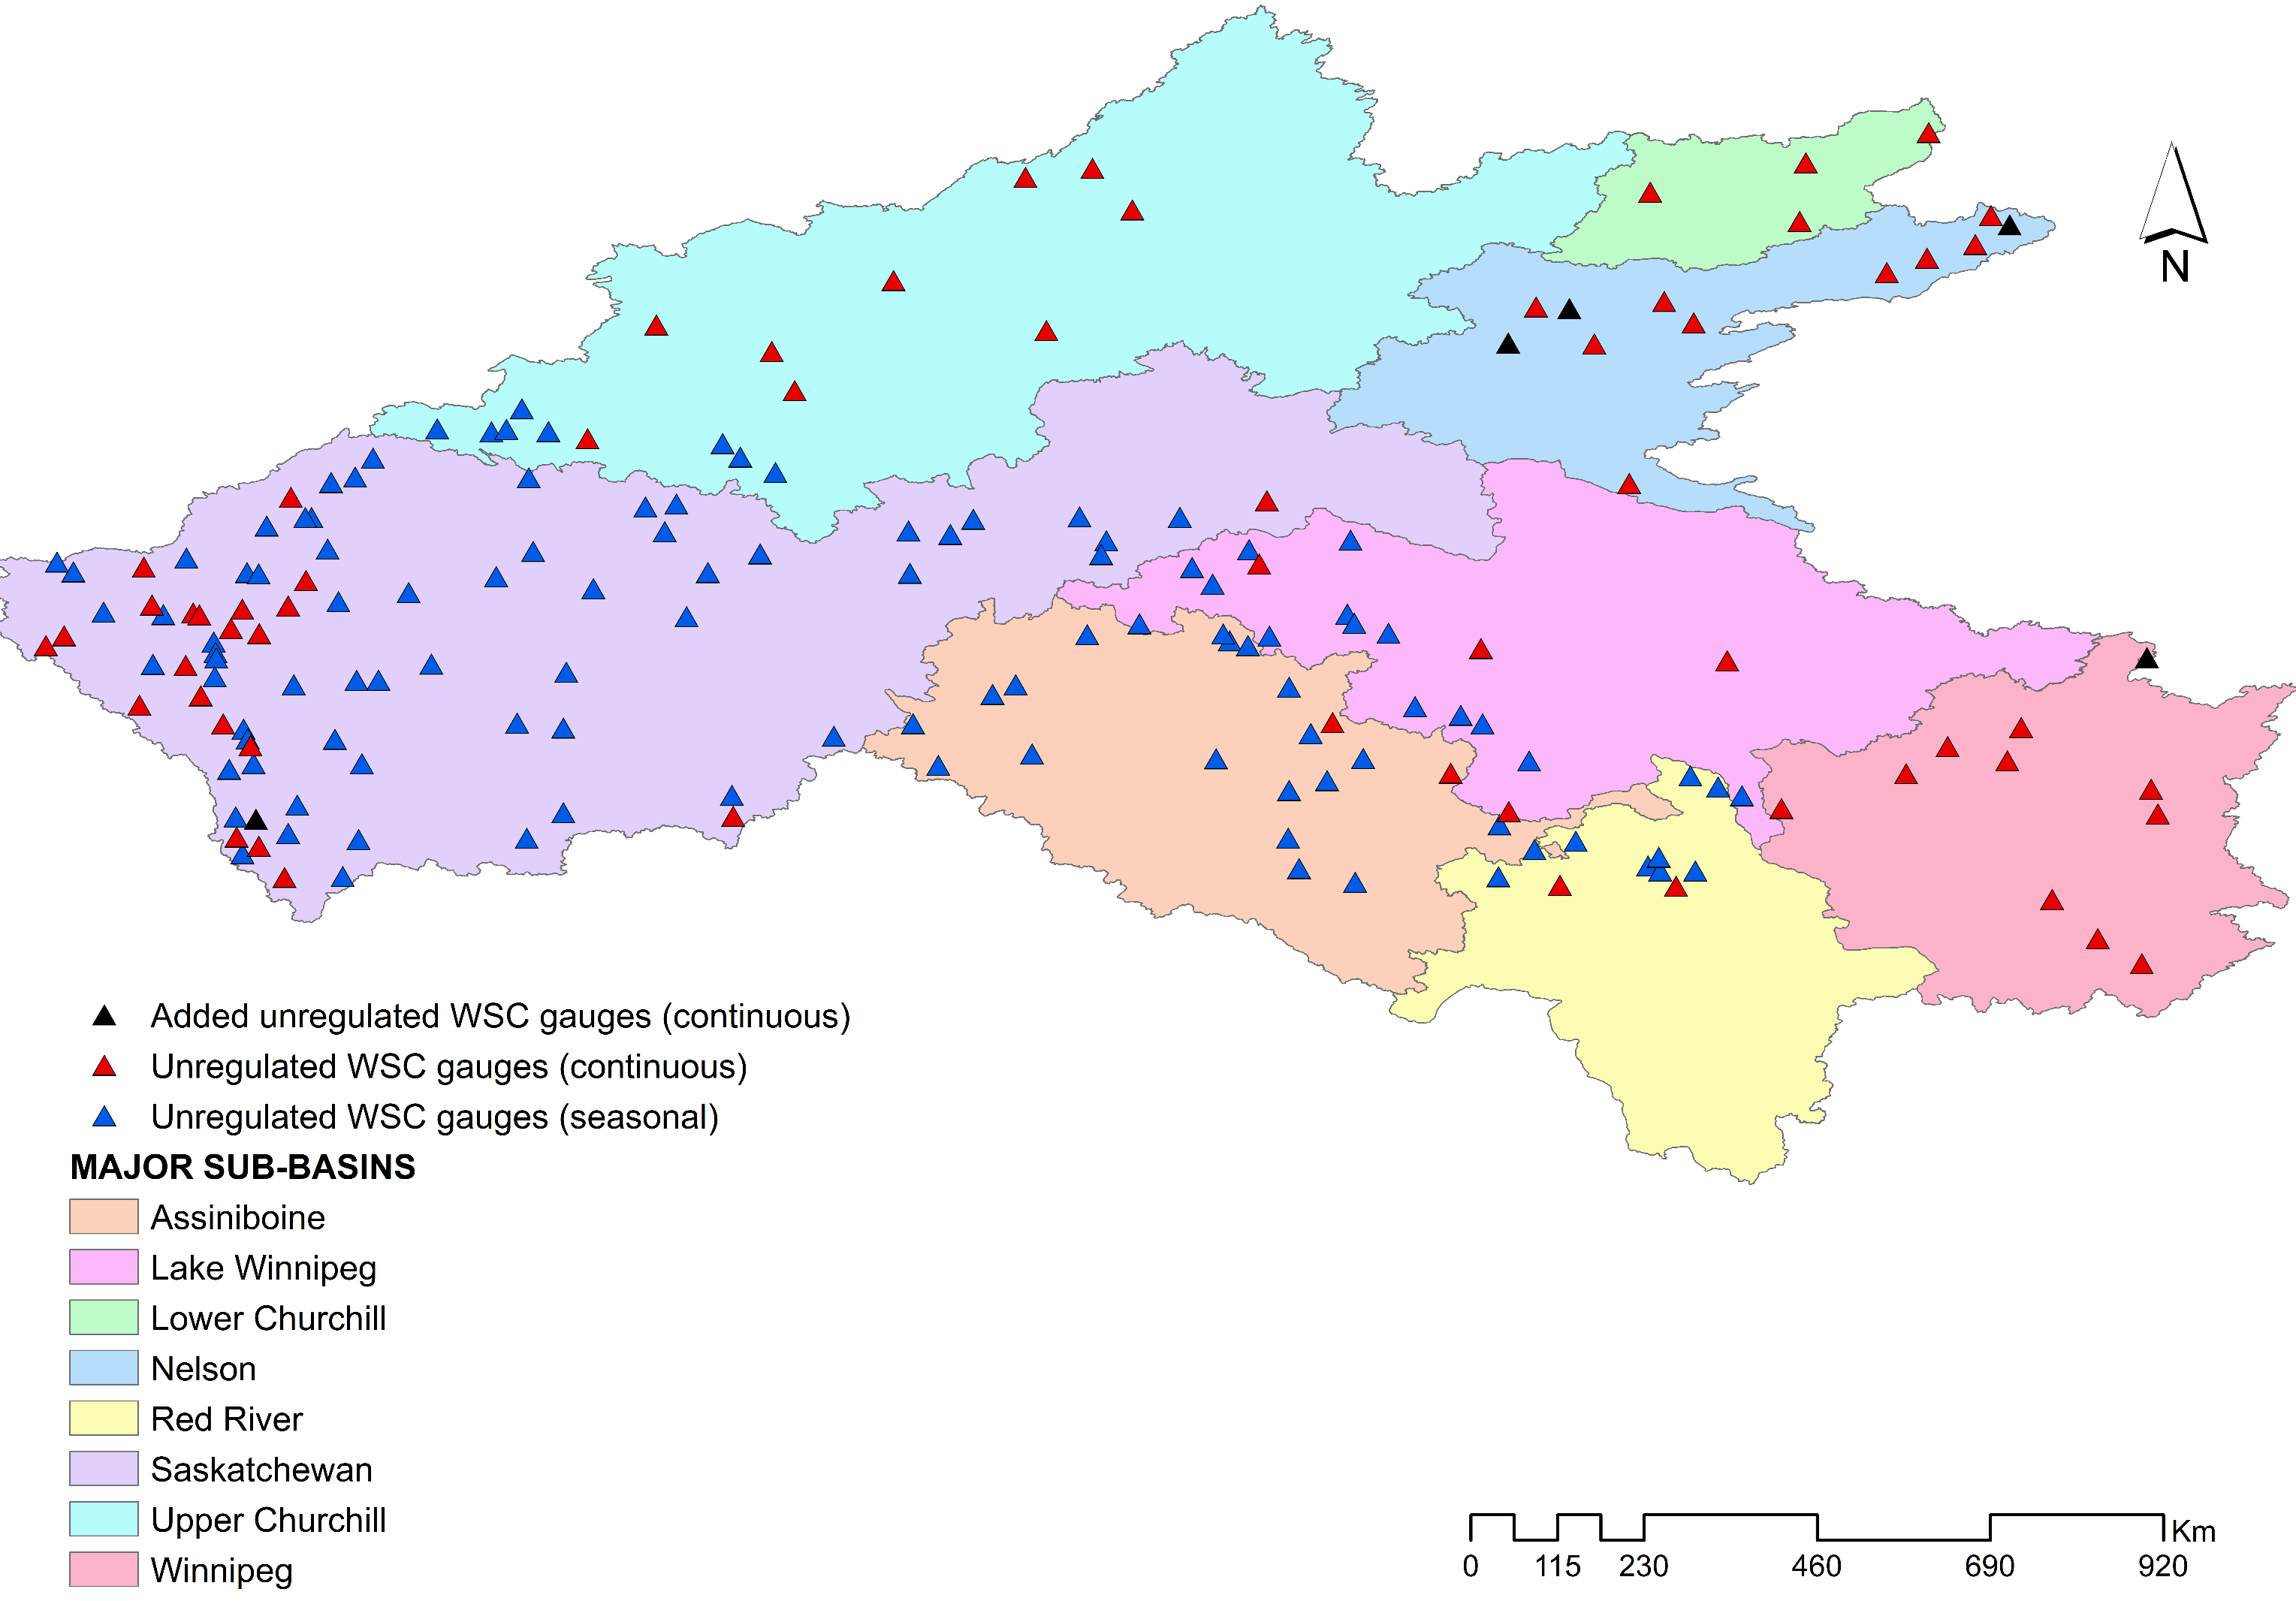
Selection of natural gauge stations for calibration after QA/QC of measured streamflow time-series
Sub-basins | Number of WSC natural stations
Assiniboine | 22
Lake Winnipeg | 17
Winnipeg river | 11
Upper Churchill | 17
Lower Churchill | 4
Saskatchewan river | 85
Red River | 10
Nelson river | 12

Slide 6
User-selected stations to be removed if agreed
05BL012 --> Sheep river at Okotoks (MH-WATFLOOD)
05FA011 --> Battle river at Duhamel (MESH)
05AB046 --> Willow Creek at Highway NO. 811 (MESH)
05RD007 --> Berens river at outlet of Long Lake (HYPE)
05RD008 --> Pigeon river at outlet of Round Lake (HYPE)
05OF009 --> Roseisle creek near Roseisle (HEC-HMS)
05OF010 --> Boyne river near Treherne (HEC-HMS)

Slide 7
Hydrological Prediction for the Environment – HYPE
By:
Ajay Bajracharya
(University of Calgary)

Slide 8
1. Study Area
Nelson Churchill River Basin
Gross Area
1.4 million square kilometers
Elevation Range
Sea level to 3548 M.S.L.
Figure 1 Map of your study Area showing major topographic features, gauging stations and river network
Characteristic/ Data type | Information/Product | Source
Topography | USGS: Hydro1K | https://lta.cr.usgs.gov/HYDRO1K
Soil characteristics | Harmonized World Soil Database V1.2 | Nachtergaele et al. (2010)
Land use | ESA CCI LC 2010 v1.4 | ESA Climate Change Initiative
Lake and wetland | Global Lake and Wetland Database (GLWD) | Lehner and Doll (2004)
Reservoirs | Global reservoir and Dam database (GRanD) v1.1 | Lehner et al. (2011)
Discharge | HYDAT, 2. USGS | Environment Canada waterdata.usgs.gov/nwis
Meteorological | Hydro-GFD | Berg et al. (2017)
Snow | GlobSnow | www.globsnow.info
Glacier fluctuations | World Glacier Monitoring Service (WGMS) | Zemp et al. (2009)
Evapotranspiration | FLUXNET | fluxnet.ornl.gov

Slide 9
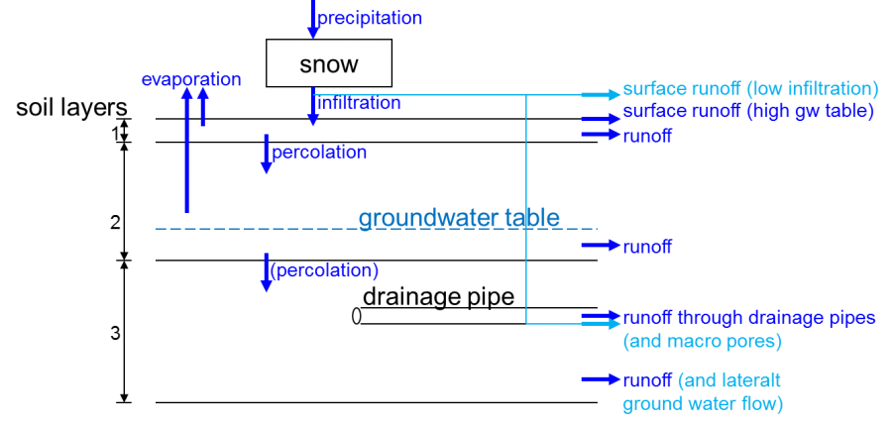
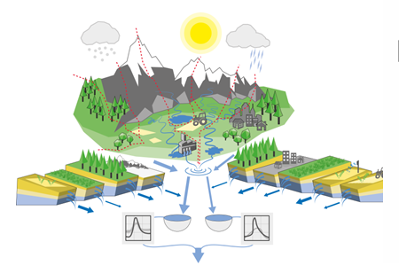
2. Model Description
Processes above ground
Temperature and Precipitation
Atmospheric Deposition
Evapotranspiration
Figure 3 Illustrations of flow path in the soil in the HYPE model
Wetland
Land Routines
Glaciers/snow
Point Sources
River
Irrigation
Soil
Rivers and Lakes
Lake
Routing Processes
Deep Processes
Regional Groundwater
Aquifers
Figure 2 Components of HYPE model
Figure 4 Sub-basin discretization in your Model (eg. HYPE)

Slide 10
3. Input Data Used
Table 1 Description of the input data used for the model setup and their sources
Characteristic/Data type | Information/Product | Source
Topography | USGS: Hydro1K | https://lta.cr.usgs.gov/HYDRO1K
Soil characteristics | Harmonized World Soil Database V1.2 | Nachtergaele et al. (2010)
Land use | ESA CCI LC 2010 v1.4 | ESA Climate Change Initiative
Lake and wetland | Global Lake and Wetland Database (GLWD) | Lehner and Doll (2004)
Reservoirs | Global reservoir and Dam database (GRanD) v1.1 | Lehner et al. (2011)
Discharge | HYDAT, 2. USGS | Environment Canada waterdata.usgs.gov/nwis
Meteorological | Hydro-GFD | Berg et al. (2017)
Snow | GlobSnow | www.globsnow.info
Glacier fluctuations | World Glacier Monitoring Service (WGMS) | Zemp et al. (2009)
Evapotranspiration | FLUXNET | fluxnet.ornl.gov

Slide 11
SWAT-GIW
By:
Ameer Muhammad
(Water Security Agency)

Slide 12
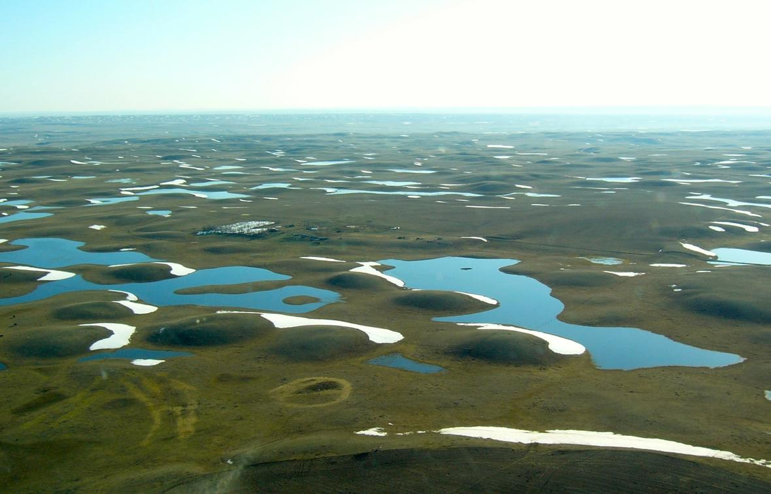
1. Prairie Pothole Region (PPR)
Prairie pothole Region
Known for its complex topographic landscape
Fill-Spill processes
Variable contributing area dynamics
Cold Region processes
Blowing snow
Infiltration to frozen ground
Agriculture expansion
Climate change
Figure 1 Prairie Pothole Region (PPR): source (USGS)

Slide 13
1. Study Area
Upper Assiniboine River Basin
Importance to SK and MB
Shellmouth reservoir
Basin Characteristics
Area = 13,000 km²
Agriculture = 72%
Forest = 12%
GIWs (Potholes) = 140 km²
Density of GIWs = 3.5/km²
Figure 2 Geospatial location of Upper Assiniboine River Basin (UARB)- along with CaPA gridpoints and hydrometric station

Slide 14
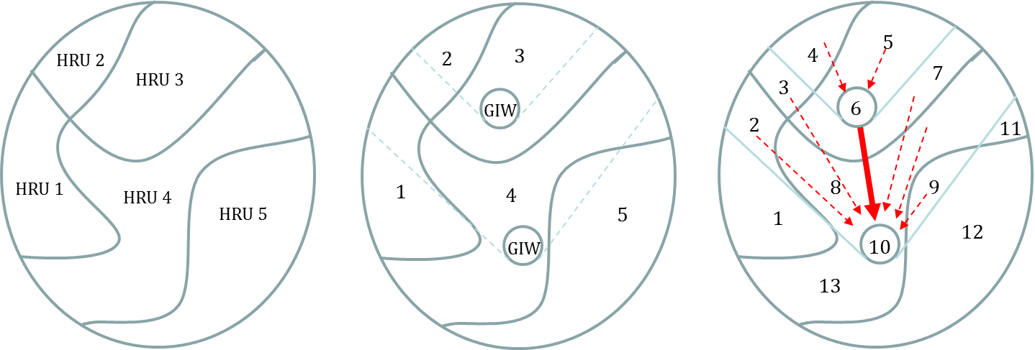
2. Model Description
SWAT works based on Hydrologic Response Unit (HRU): Soil type+ land use +DEM
Wetlands in each subbasin are aggregated: lumped pothole wetland representation
Modified concept added another attribute, shape file of Geographically Isolated Wetlands (GIWs), while generating HRUs: spatial enhancement of pothole wetlands + fill-spill processes + Variable contributing area dynamics
(a)
(b)
(c)
Figure 3 Modified concept of HRU representation: (a) Standard SWAT model (b) GIW atop HRU with along with drainage area (c) Revised HRUs

Slide 15
3. Input Data Used
Table 1 Description of the input data used for the model setup and their sources
Characteristic/ Data type | Information/Product | Source
Topography | CDED: 20- m | http://geogratis.gc.ca/
Soil characteristics | AAFC- Manitoba regional office | http://www.globalsoilmap.net/
Land use | Circa 2000 land use data | http://geogratis.gc.ca/
Meteorological | CaPA, 2. NCEP-CFSR | https://weather.gc.ca/ https://globalweather.tamu.edu/
Discharge | Water Survey of Canada | https://wateroffice.ec.gc.ca/
Thank you

Slide 16
References
Muhammad, A.; Evenson, G.R.; Stadnyk, T.A.; Boluwade, A.; Jha, S.K.; Coulibaly, P. Impact of model structure on the accuracy of hydrological modeling of a Canadian Prairie watershed. J. Hydrol. Reg. Stud. 2019, 21, 40–56.
Muhammad, A.; Evenson, G.R.; Stadnyk, T.A.; Boluwade, A.; Jha, S.K.; Coulibaly, P. Assessing the Importance of Potholes in the Canadian Prairie Region under Future Climate Change Scenarios. Water 2018, 10, 1657.

Slide 17
MH-WATFLOOD
By:
Mark Gervais, Shane Wruth, Kevin Sagan & Phil Slota
(Manitoba Hydro)

Slide 18
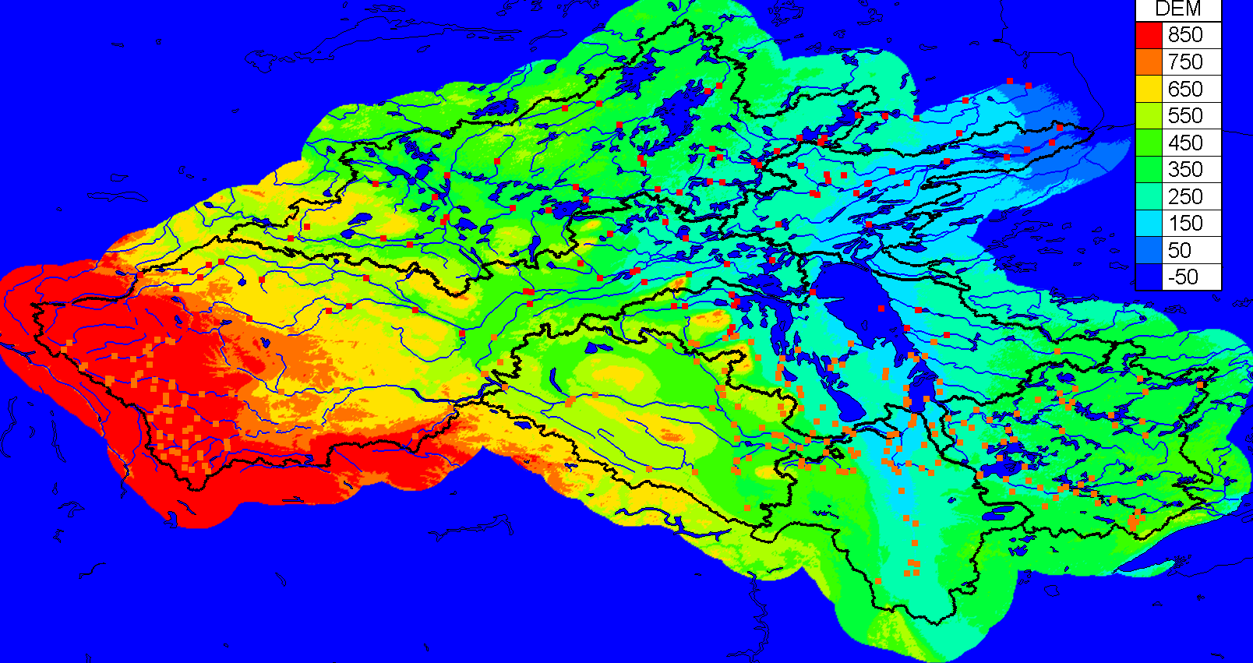
1. Study Area
Nelson Churchill River Basin
Gross Area
1.4 million square kilometers
Elevation Range
Sea level to 3548 M.S.L.
Contains many unique hydrological processes:
Permafrost
Non-contributing areas
Mountainous processes
Wetlands
Figure 1 Manitoba Hydro Study Region
Characteristic/ Data type | Information/Product | Source
Topography | USGS: Hydro1K | https://lta.cr.usgs.gov/HYDRO1K
Soil characteristics | Harmonized World Soil Database V1.2 | Nachtergaele et al. (2010)
Land use | ESA CCI LC 2010 v1.4 | ESA Climate Change Initiative
Lake and wetland | Global Lake and Wetland Database (GLWD) | Lehner and Doll (2004)
Reservoirs | Global reservoir and Dam database (GRanD) v1.1 | Lehner et al. (2011)
Discharge | HYDAT, 2. USGS | Environment Canada waterdata.usgs.gov/nwis
Meteorological | Hydro-GFD | Berg et al. (2017)
Snow | GlobSnow | www.globsnow.info
Glacier fluctuations | World Glacier Monitoring Service (WGMS) | Zemp et al. (2009)
Evapotranspiration | FLUXNET | fluxnet.ornl.gov

Slide 19
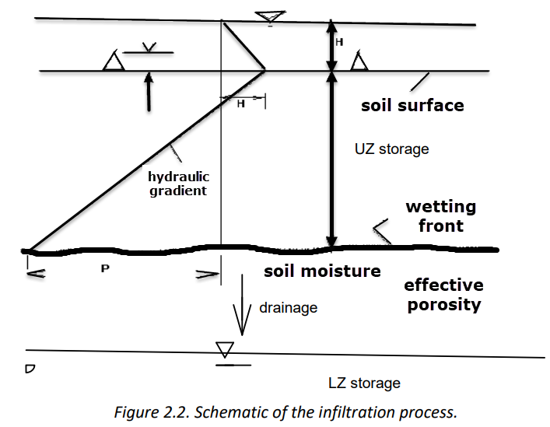
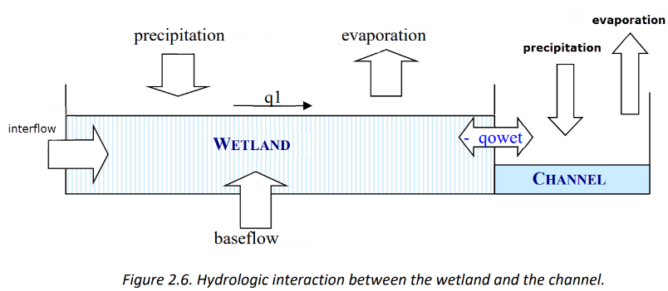
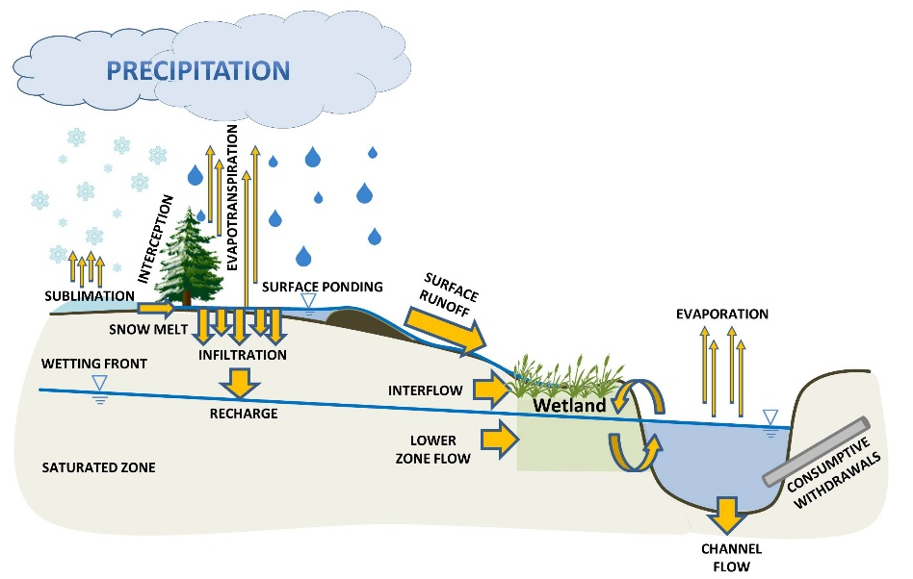
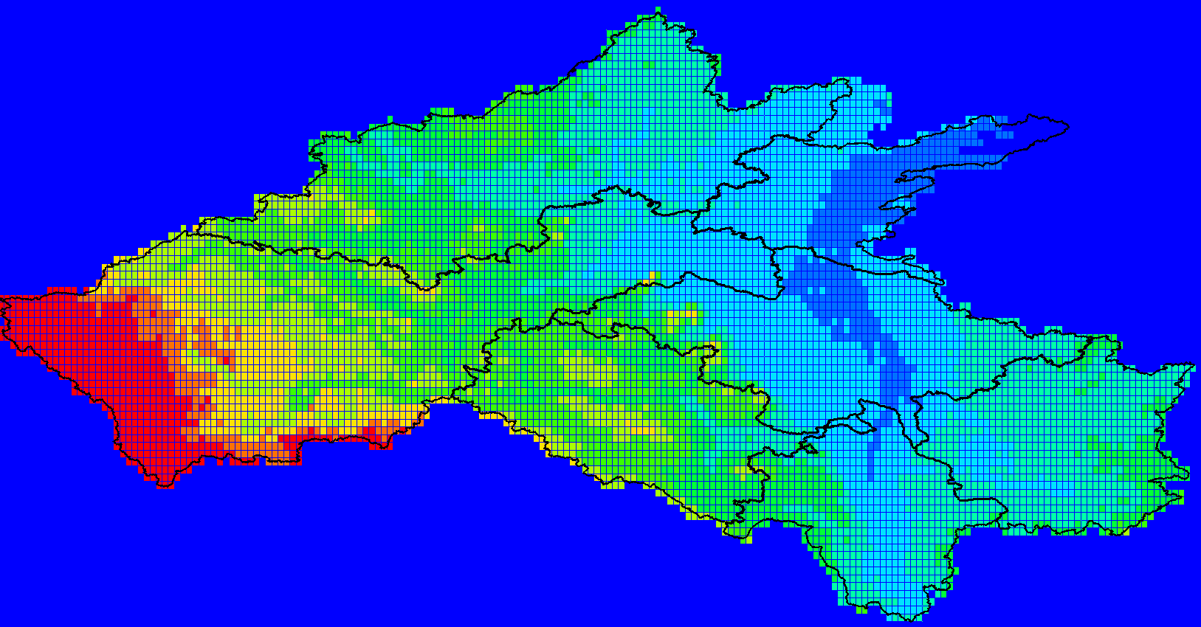
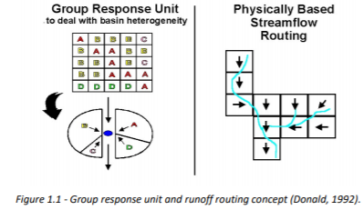
2. Model Description
Figure 3 Illustrations of flow path in the soil in WATFLOOD
Figure 2 Schematic Diagram of WATFLOOD
Figure 4 Sub-basin discretization in WATFLOOD

Slide 20
3. Input Data Used
Table 1 Description of the input data used for the model setup and their sources
Characteristic/ Data type | Information/Product | Source
Topography | Shuttle Radar Topography Mission (SRTM) | https://www.usgs.gov/centers/eros/science/usgs-eros-archive-digital-elevation-shuttle-radar-topography-mission-srtm-1-arc?qt-science_center_objects=0#qt-science_center_objects
Soil characteristics | Surficial Materials of Canada/ Surficial Materials in the Conterminous United States | https://geoscan.nrcan.gc.ca/starweb/geoscan/servlet.starweb?path=geoscan/downloade.web&search1=R=295462 https://pubs.usgs.gov/ds/425/
Land use | The North American Land Change Monitoring System | http://www.cec.org/tools-and-resources/map-files/land-cover-2010-landsat-30m
Lake and wetland
Reservoirs
Discharge | HYDAT, 2. USGS | Water Survey of Canada waterdata.usgs.gov/nwis
Meteorological | CaPA (precipitation) ECCC (temperature) | 1. https://weather.gc.ca/grib/grib2_RDPA_ps10km_e.html 2. https://climate.weather.gc.ca/
Snow
Glacier fluctuations
Evapotranspiration

Slide 21
ArcSWAT modelling of hydrologic behavior for Red River Basin with control points
By:
Yinlong Huang
(University of Manitoba)

Slide 22
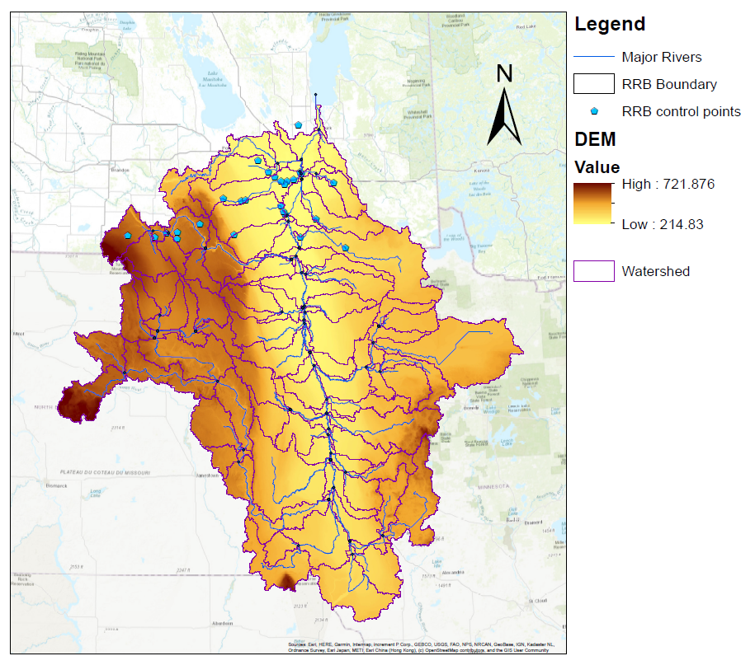
1. Study Area
Red River Basin
Gross Area
128,148 square kilometers
Elevation Range
702 to 2366 M.S.L.
Figure 1 Red River Basin with major rivers, major control points and DEM
Characteristic/ Data type | Information/Product | Source
Topography | USGS: Hydro1K | https://lta.cr.usgs.gov/HYDRO1K
Soil characteristics | Harmonized World Soil Database V1.2 | Nachtergaele et al. (2010)
Land use | ESA CCI LC 2010 v1.4 | ESA Climate Change Initiative
Lake and wetland | Global Lake and Wetland Database (GLWD) | Lehner and Doll (2004)
Reservoirs | Global reservoir and Dam database (GRanD) v1.1 | Lehner et al. (2011)
Discharge | HYDAT, 2. USGS | Environment Canada waterdata.usgs.gov/nwis
Meteorological | Hydro-GFD | Berg et al. (2017)
Snow | GlobSnow | www.globsnow.info
Glacier fluctuations | World Glacier Monitoring Service (WGMS) | Zemp et al. (2009)
Evapotranspiration | FLUXNET | fluxnet.ornl.gov

Slide 23
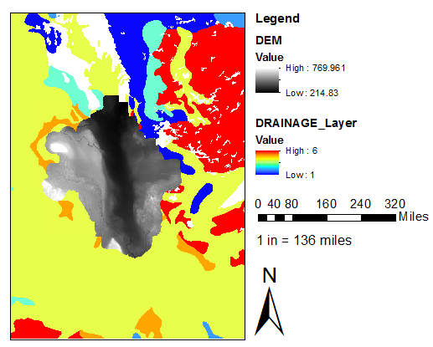
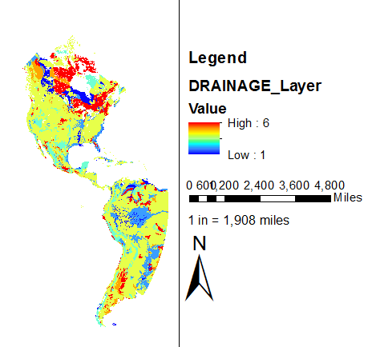
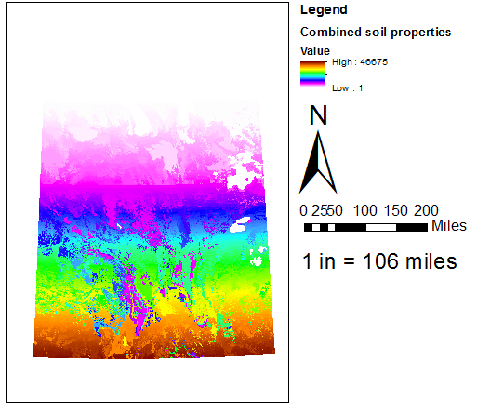
2. Soil Map Processing
Figure 3 Illustrations of soil data extraction
Spatial Analyst Tool Extraction
Extract by mask
Figure 2 Initial Soil Properties File: Drainage Class NetCDF file (apart from hydraulic conductivity)
NetCDF file can be read by ArcMap:
Multidimensional tool Make NetCDF raster layer (use default setting)
Figure 4 Combination of multiple soil properties
Spatial Analyst Tool Local
Combine

Slide 24
3. Hydraulic Conductivity Processing
Soil Hydraulic Conductivity General Information
Soil hydraulic conductivity data was provided from a different database.
Link: http://globalchange.bnu.edu.cn/research/soil5.jsp
File format: unprocessed binary file, no header
Data format: log 10 transformed hydraulic conductivity
Content: 8 separate files for 8 different layers, depth varies according to different vertical resolution
4 vertical resolution:
SoilGrids (0 - 0.05 m, 0.05 - 0.15 m, 0.15 - 0.30 m, 0.30 - 0.60 m, 0.60 - 1.00 m, and 1.00 - 2.00 m)
Noah-LSM (0 - 0.1 m, 0.1 - 0.4 m, 0.4 - 1.0 m, and 1.0 - 2.0 m)
JULES (0 - 0.1 m, 0.1 - 0.35 m, 0.35 - 1.0 m, and 1.0 - 3.0 m)
CoLM/CLM (0 - 0.0451 m, 0.0451 - 0.0906 m, 0.0906 - 0.1655 m, 0.1655 - 0.2891 m, 0.2891 - 0.4929 m, 0.4929 - 0.8289 m, 0.8289 - 1.3828 m, 1.3828 - 3.8019 m)

Slide 25
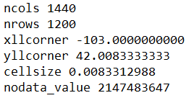
Processing procedures
Matlab code developed to extract data and save as ASCII file
Save the file and Matlab code under same file path
Input desired latitude/longitude range (starting lat/long and ending lat/long)
Run the code. ASCII file are created under the same path
Transform 8 layers into 2 layers
Import all ASCII file into excel
Use each hydraulic conductivity value and divide by depth of each layer, obtain total time for each cell on each layer
Sum up total time for layer 1 to 4 and layer 5 to 8
Use total time and divide by total depth of layer 1 to 4 and layer 5 to 8
Once finished, use another Matlab code to save excel file as txt file, space delimited
Create header
Header for saved .txt file should follow this order:
Once finished, use ArcMap tool to import hydraulic conductivity:
Conversion tool To Raster ASCII to Raster

Slide 26
Deliverables & Follow-up
1. Other modellers can also prepare a 5-min presentation of their model for the next meeting. 1-3 slides presentation should be sent to Hervé by May 6, 2020 at the latest.
Presentation on: VIC (UNBC), SUMMA (USask), SWAT-GWF (UAlberta), HBV-EC, WATFLOOD-MI (Manitoba Infrastructure), USASK (MESH), HEC-HMS (Strategic Consulting)
2. Scott from Strategic Consulting will be presenting on a comparison of ERA5 with another meteorological reanalysis product.
3. Hervé to follow-up with Bruce Davinson for the selection of USGS unregulated gauge stations.
4. A SLACK channed is available to facilitate informal communication for Nelson-MiP. We are all encourage to use it.
Channel link: https://uc-hal.slack.com/archives/C011BTG7GL8
Channel name: #ncrb_mip
5. Next meeting scheduled for Wednesday May 13, 2020 @10:00AM MST

